Slide 1
Elevator Controller
in Verilog HDL
VLSI LAB PROJECT
4-floor SCAN scheduling, stepper motor drive and 7-segment floor display- RTL Design and Simulation in Verilog HDL
Team · Tsering Angmo - 20244165
Members: · Ujjwal Pratap Singh - 20244166
· Vaibhav Raj – 20244167
MNNIT ALLAHABAD
ECE B2
Notes:
Introduce the project and the three modules: elevator (control logic), stepper_motor, seven_seg_disp, tied together by elevator_cont_Machine.

Slide 2
Objectives
Control
Schedule
Design a digital logic circuit that moves an elevator through 4 floors, f0 to f3, held in a 2-bit register current_floor.
Use the SCAN algorithm so requests are served in the direction of travel before reversing, which cuts waiting time.
Safety and Overrides
Peripherals
Integrate emergency overload protection(750kg threshold) and manual door hold/ quick close overrides.
Model a 4-phase stepper motor driver, a 7-segment display decoder and an overload sensor input, all verified by simulation in Verilog.
Notes:
Everything is implemented and verified at the software (RTL simulation) level.

Slide 3
Inputs
Signal | Width | Meaning
move_up_call | 4 bits | Hall button: passenger wants to go up (bits 0 to 2 used)
move_down_call | 4 bits | Hall button: passenger wants to go down (bits 1 to 3 used)
req_floor | 4 bits | Button inside the cabin: destination floor
open_door | 1 bit | Reopen the door and wait extra time
close_door | 1 bit | Close the door immediately
over_weight | 1 bit | Sensor: 1 when load is above 750 kg
clk, rst | 1 bit each | Clock for stepper and display; reset
Notes:
Bit number = floor number. Example: req_floor = 0100 means floor 2.

Slide 4
Outputs and Internal Signals
Signal | Width | Meaning
current_floor | 2 bits | 00 = f0, 01 = f1, 10 = f2, 11 = f3
direction | 2 bits | 01 = up, 10 = down, 11 = stop
door_state | 1 bit | 1 = open, 0 = closed
over_weight_alert | 1 bit | 1 while the cabin is overloaded
q | 4 bits | Stepper motor coil pattern
disp | 8 bits | Seven-segment pattern for current_floor
current_floor and direction are internal wires in the top module; they feed the display and the motor.
Notes:
Outputs of the top module: door_state, over_weight_alert, disp, q.

Slide 5
Methodology
1. Request
2. Compare
3. Weight
4. Move
A floor call or in-cabin request is raised.
Equal to current floor: open door.
Over 750 kg: alert and wait.
Higher: go up. Lower: go down.
5. Reopen
6. Repeat
open_door extends the door time; close_door ends it early.
Cleared requests drop out and the cycle restarts.
Notes:
Walk through the flow chart: request, compare with current floor, overweight check, then up or down. The code uses 2-bit floors f0..f3.

Slide 6
SCAN Algorithm
The elevator sweeps one way, stopping at every requested floor. At the last request in that direction it reverses. It stops when no request is left.
Up sweep
Down sweep
scan_direction = 1. Scans floors 0 to 3 in upflr_call_arr and flr_req_arr. At floor 3 the direction flips to 0.
scan_direction = 0. Scans floors 3 to 0 in downflr_call_arr and flr_req_arr. At floor 0 the direction flips to 1.
Worked example
Elevator at f0, requests for f1 and f3 while another call waits at f2 (up). Up sweep serves f1, f2, f3 in order. If a down call arrives at f1 meanwhile, it waits for the down sweep.
Notes:
Example is illustrative. The key point: requests behind the car wait for the reverse sweep.

Slide 7
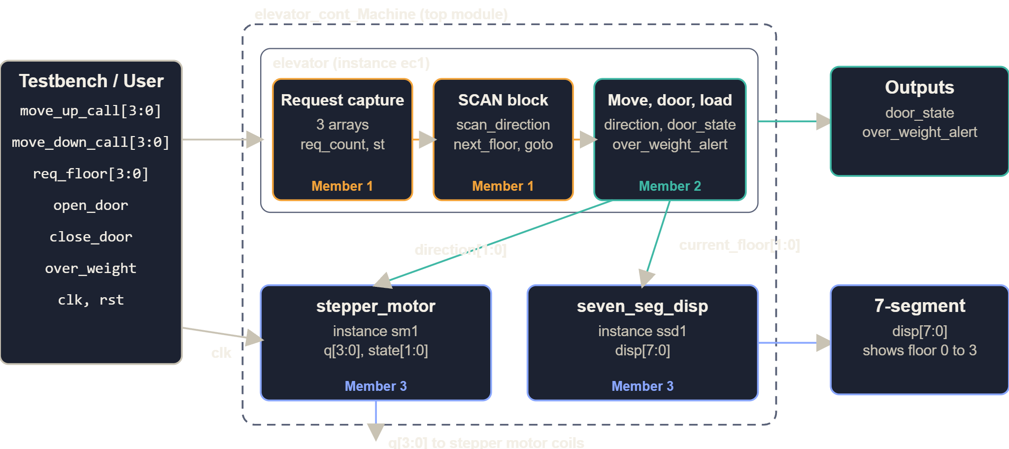
System Block Diagram
Notes:
Bit number = floor number. Example: req_floor = 0100 means floor 2.

Slide 8
Capturing Requests
Storage
Trigger
Three 1-bit arrays with 4 slots each: upflr_call_arr, downflr_call_arr, flr_req_arr. Slot index = floor number.
One always block per input group, triggered on posedge of each button bit. If the bit is 1 and its slot is 0, the slot is set to 1.
Counting
Start flag
req_count [3:0] adds 1 per new request. A repeat press is ignored because the slot is already 1.
st goes 1 when req_count changes from 0 to 1. This wakes the SCAN block. st returns to 0 when req_count is 0.
Mapping: move_up_call[i] to upflr_call_arr[i], move_down_call[i] to downflr_call_arr[i], req_floor[i] to flr_req_arr[i].
Notes:
Up calls exist only for floors 0 to 2 and down calls only for floors 1 to 3.

Slide 9
SCAN Block
Register | Role
scan_direction | 1 = sweeping up, 0 = sweeping down
next_floor [1:0] | Target floor chosen by the loop
x | Set to 1 to break out of the for loop
goto | Pulses to wake the movement block
complete | Pulses when a floor is served, to rescan
d_c | Start the next sweep from the end floor after a reversal
rpt, rpt1 | Clock-synchronised retry while requests remain
Loop: start at current_floor (or at the end floor if d_c = 1), find the first slot that is 1, store its index in next_floor, set goto = 1.
Notes:
The block runs when current_floor changes or st, complete or rpt1 rise.

Slide 10
Movement and Door Logic
Compare
Travel time
next_floor equals current_floor: serve. Greater: direction = move_up (01). Less: direction = move_down (10).
#300 delay, about 3 s, then current_floor is changed by 1.
Door
Buttons
door_state 1 = open, 0 = closed. Normal dwell is 20 x #15, about 3 s.
open_door is latched in wire_open_door for 20 x #20 extra, about 4 s. close_door is latched in wire_close_door and ends the wait early.
Notes:
direction codes: 01 up, 10 down, 11 stop.

Slide 11
Clearing Requests and Overweight
Clearing
Overweight
At the served floor cf, the matching array slots are set to 0 and req_count drops by 2 if both slots were set, else by 1. Then complete = 1 restarts SCAN.
If over_weight = 1: direction = stop, door_state = open, over_weight_alert = 1. Normal operation resumes when it returns to 0.
Notes:
Only the matching direction array is cleared: up array on an up sweep, down array on a down sweep, and flr_req_arr in both.

Slide 12
Timing and Direction Codes
Event | Code | Time
Move one floor | #300 delay then current_floor ± 1 | about 3 s
Normal door dwell | 20 x #15 loop, door_state = 1 | about 3 s
Extra time (open_door) | 20 x #20 loop | about 4 s
Close early | wire_close_door = 1 ends the loop | immediate
timescale is 10 ms per unit. direction codes: 01 up, 10 down, 11 stop.
Notes:
Delays are simulation delays, so they model real motion and door time.

Slide 13
Stepper Motor Driver
A stepper motor turns in small steps. Energising its 4 coils in a repeating pattern rotates the shaft; reversing the pattern reverses the rotation.
Input
Output
Step counter
direction [1:0] from the elevator: 01 = up, 10 = down, 11 = stop.
q [3:0], one bit per coil. Initial value q = 4h3.
state [1:0] counts 0 to 3 and wraps, adding 1 on every rising clock edge while moving.
While moving
While stopped
A case on state picks the next q. The same state gives a different pattern for up and for down.
direction = 11: q = q. The coils keep their last pattern, so the motor holds position.
Notes:
One step per clock edge, so clock speed sets motor speed. The elevator block decides how long to move.

Slide 14
Step Sequence
state | Up (01) | Down (10) | Hex up / down
0 | 0011 | 0110 | 3 / 6
1 | 1001 | 1100 | 9 / C
2 | 1100 | 1001 | C / 9
3 | 0110 | 0011 | 6 / 3
Each pattern turns on two adjacent coils at a time (full-step drive). The up column is the down column in reverse order, which flips the rotation direction.
Notes:
In the waveform, q toggles through these patterns while the elevator moves, and stays flat when it is idle.

Slide 15
Display and Integration
current_floor | disp [7:0] | Shows
00 | 01111111 | 0
01 | 00000110 | 1
10 | 01011011 | 2
11 | 01001111 | 3
Combinational case statement on current_floor. Any other value shows 10000000.
Notes:
Bit order on disp is as written in seven_seg_disp.v. Top module hooks all three blocks together.

Slide 16
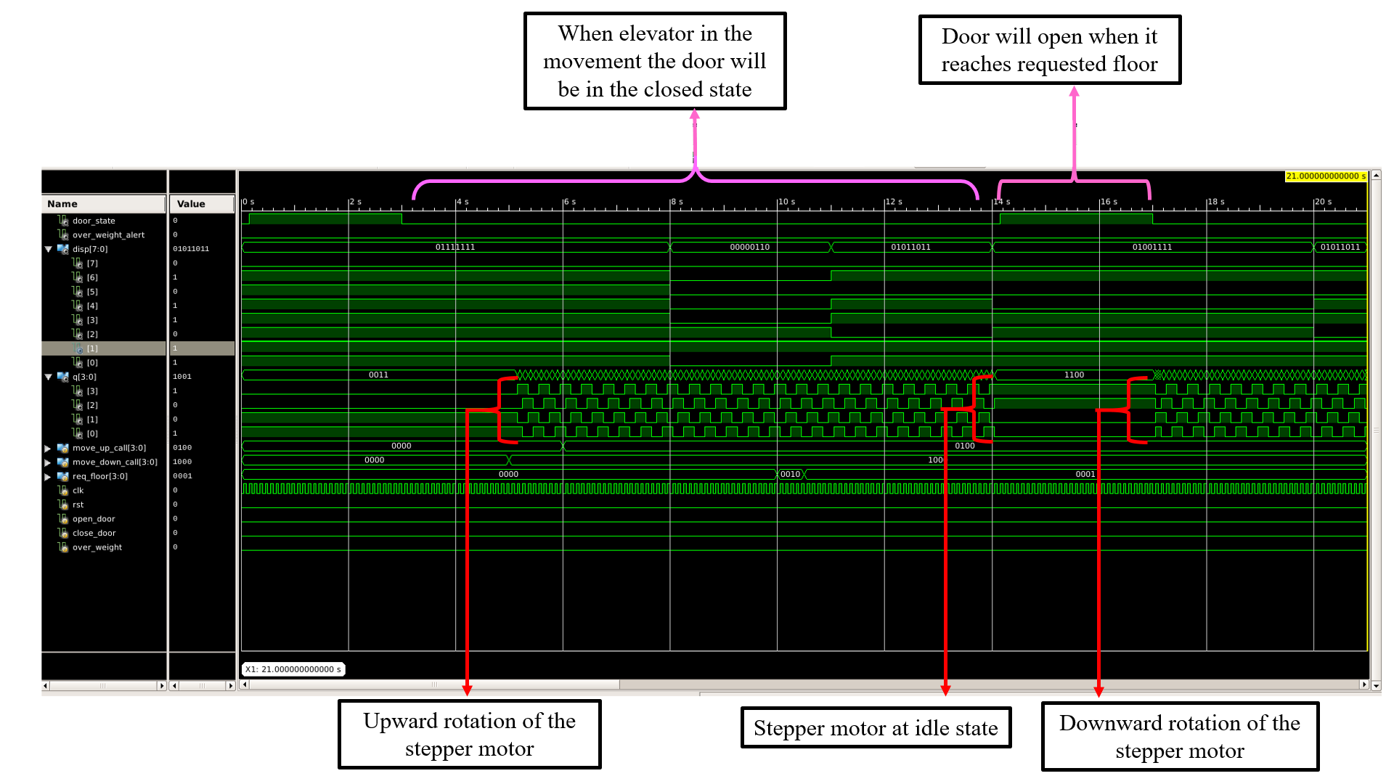
Simulation Output 1
Notes:
Paste simulation screenshot here.

Slide 17
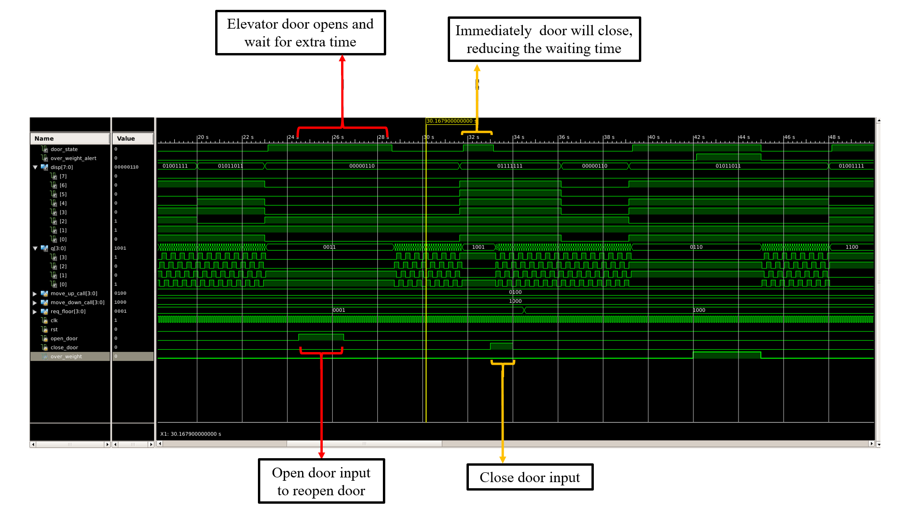
Simulation Output 2
Notes:
Paste simulation screenshot here.

Slide 18
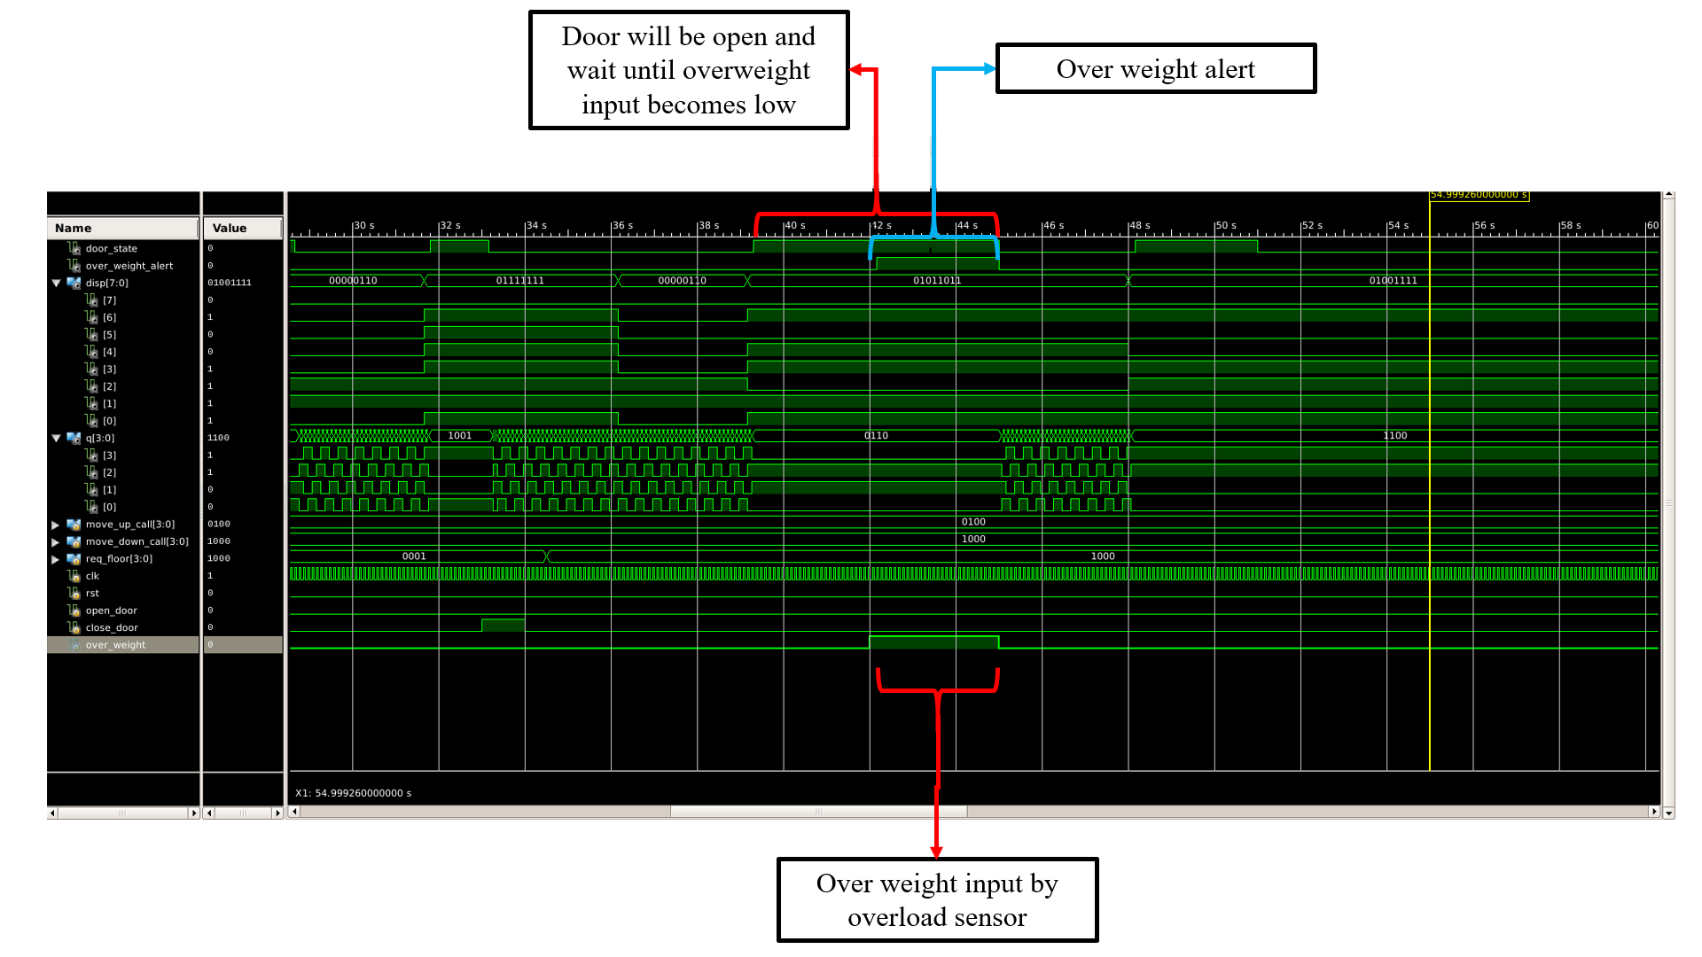
Simulation Output 3
Notes:
Paste simulation screenshot here.

Slide 19
Results
Movement
Arrival
While the elevator moves, door_state stays 0 and q cycles through the stepper pattern. Up and down show opposite sequences.
On reaching the requested floor the motor holds q, the door opens and the display shows the new floor.
Door buttons
Overload
open_door keeps the door open for extra time; close_door shuts it immediately.
With over_weight = 1 the door stays open, direction = stop and over_weight_alert = 1 until the sensor clears.
Notes:
Point to the simulation slides for each behaviour.

Slide 20
Future Work
FPGA implementation
Synthesis-friendly rewrite
Synthesise the design and test it on a development board. Replace the # delays, which are for simulation only, with clock counters.
Convert the behavioural blocks into a clocked FSM and use rst properly.
More floors
Safety features
Widen the floor registers and request arrays.
Emergency stop, door sensor, floor position sensors.
Notes:
The current design is behavioural and simulation-only; this is the path to hardware.

Slide 21
Conclusion
We designed and simulated a 4-floor elevator controller in Verilog HDL.
Scheduling
Safety and control
Peripherals
SCAN serves requests along the sweep, using three request arrays and req_count.
Door timing, open/close buttons and the overload alert work as intended.
The stepper driver and 7-segment decoder respond correctly to direction and floor.
Thank you. Questions?
Notes:
All behaviour verified in ISim waveforms. Names of presenters can go here.

